Slide 1
Biweekly Update
January 23, 2023
The Little Engineers that Could: Blake, Sam, Melanie, and Amy

Slide 2
Progress
01
02
03
Material Procurement
Regrind Preparation
Modeling and Simulation

Slide 3
Material Procurement
Vandy Recycling will provide us with a trash bag full of Coke and Pepsi bottles every month
Quantity and frequency can be changed if necessary
Bag will be delivered to outside of the 412A-C door with Blake’s name and number on it
The plastic should be presorted. As our desires change, Recycling is willing to work with us to fit the right kinds of bottles we want.

Slide 4
Regrind Preparation
We tested some methods of processing the bottles and grinding them into small, uniform flakes.
Steps to prepare bottle to be ground:
Remove caps
Rinse inside and outside with water
Remove labels with fingers/sandpaper
Remove remaining glue with acetone
Use scissors to cut the top and bottom of the bottle off, and cut the rest into strips
Attempted grinding methods:
Paper shredder - We got a paper shredder from Vanderbilt Printing Services and ran strips from the middles of the bottles through. This produced strips that were of a small width, but we could not find a way to easily run them back through width-wise to make smaller flakes.
Filabot shredder - We tried putting the tops and bottoms of the bottles into the shredder. It did not work very well; they kept getting stuck.
Scissors and filabot granulator - We used scissors to cut up strips of the middle of the bottles into sufficiently small pieces to put into the granulator. These ran through well and produced promising-looking regrind.

Slide 5
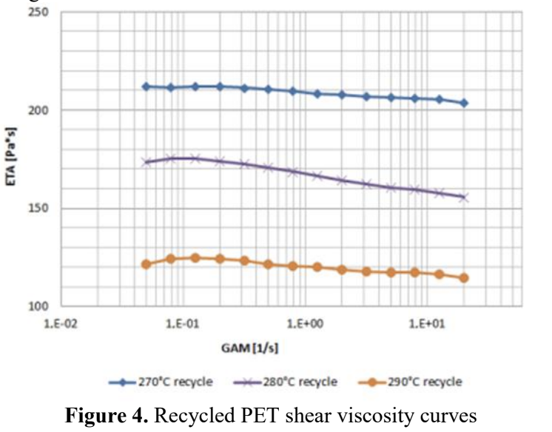
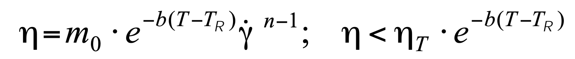
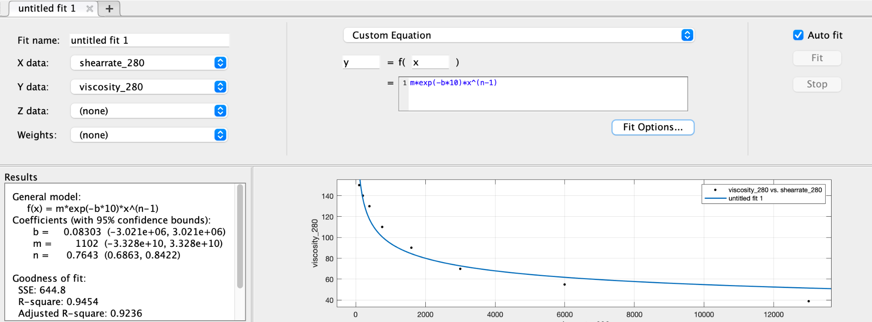
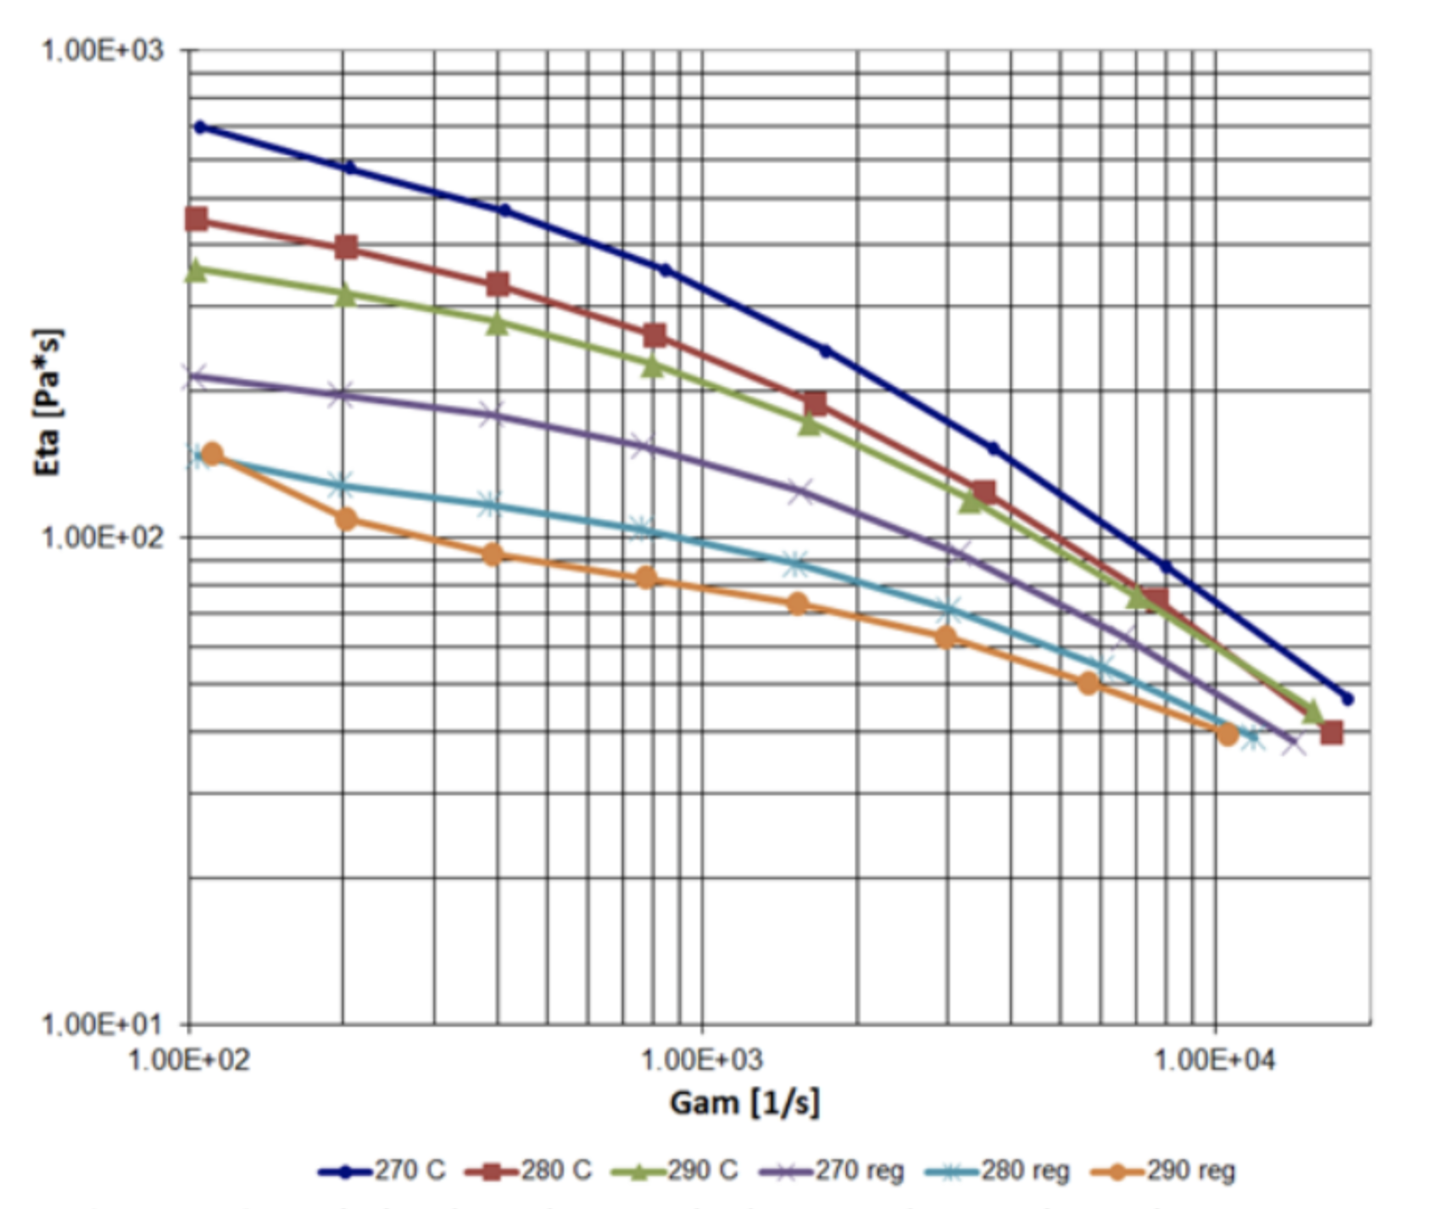
Modeling and Simulation

Slide 6
Modeling and Simulation
NEXTRUCAD Parameters to Optimize:
Screw Diameter
Flight Clearance
Section Lengths
Die Length and Diameter
Zone Temperatures
Screw Speed
Do we need to model the conical/grooved feed section differently in NEXTRUCAD or just model as normal?
How do we decide what existing screw/barrel to go with?
How to combine the custom feed section with the existing purchased portion?

Slide 7
Action Items (2 weeks)
Begin writing portions of Final Report (BC, AP)
Finalize proper regrind preparation process (BC, MM, AP)
DSC on virgin and regrind PET (BC, MM, SL, AP)
Finish NEXTRUCAD simulations (BC, SL)
Send design to machining company (BC, SL)

Slide 8
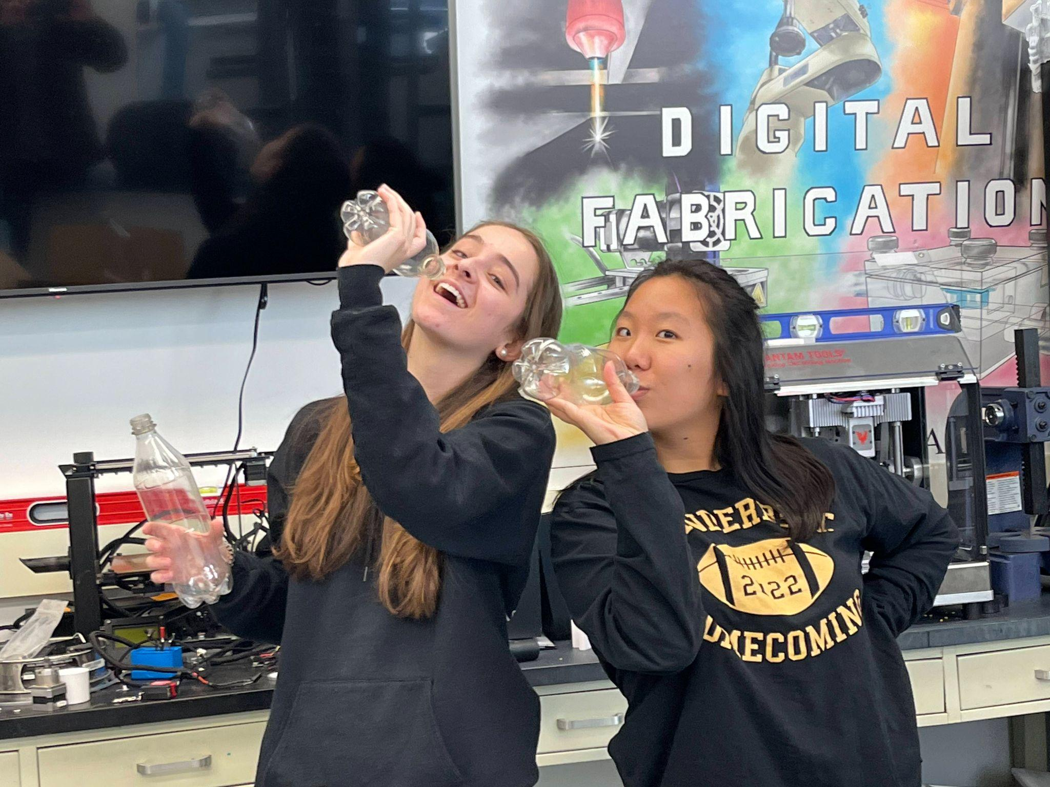
“Great minds think alike”
Methuselah

